Slide 1

The Mantid Project: Notes from an international software collaboration
Nick Draper
Tessella

Slide 2
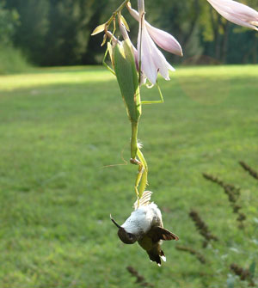
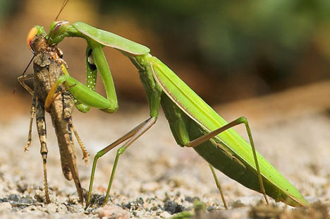
Overview
Mantid Introduction
Why collaborate?
Collaboration Models
ISIS - SNS & HFIR collaboration
Organisation
Benefits
Lessons Learned

Slide 3
Project History
July 2007 Requirements & Design
April 2008 V 1.0 First instrument support
Feb 2010 V1.1 Support multiple techniques
April 2010 Collaboration with SNS & HFIR

Slide 4

Project Goals
Goals
Consolidate the data analysis software for neutron scattering without restricting the needs of the instrument scientists
Key requirement
Create a Data Analysis framework
not instrument or technique/dependent
Cross-platform
Windows, Linux, Mac
Easily extensible
Freely redistributable

Slide 5
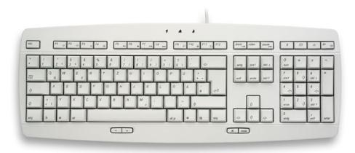

Framework vs individual applications
Less time spent developing input and output routines
More time on scientific algorithms
Cross benefits from other groups
Lower support requirements
Better documentation and training
Fewer single points of failure
Structure for further developments

Slide 6
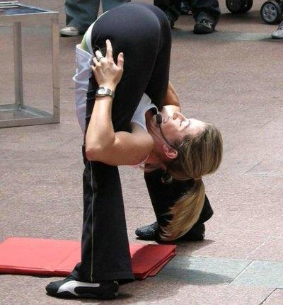
Framework flexibilty
Instrument independence
Virtual instrument defined
Loaded from xml definition
Location, rotation and shape of every pixel
Sample
Source
Technique independence
Algorithms
Unit Reduction and analysis steps
Workflow scripts
Chain algorithms to perform a reduction workflow

Slide 7

Framework flexibilty
Plug in extensions
Common
Algorithms – C++ or Python
Instruments
Workflow scripts
Custom user interfaces
Custom algorithm dialogs
Less frequent
Workspaces
Units
Optimisation
Functions & models
Optimisers & cost functions
Constraints

Slide 8
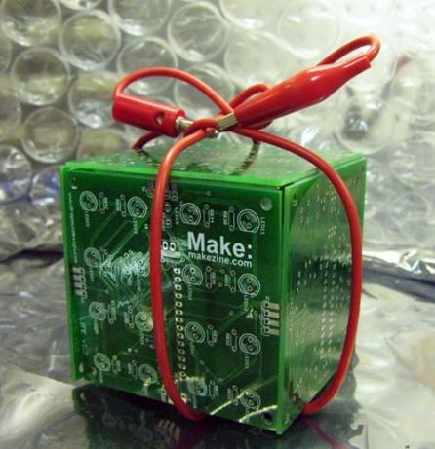
Open Source
GPL v3
Free to use
Source code openly available
Results cannot be sold
Unless you own the copyright
Good basis for collaboration
Sharing benefits to wider community
Why not LGPL, BSD etc?

Slide 9
Future Development Scope
Reduction
Analysis
Spallation & Reactor
Technique support
Inelastic
Direct
Indirect
Diffraction
Powder
Engineering
Single Crystal
Diffuse scattering
Disordered Materials
Large Scale Structures
Small angle
Reflectometry
Muons

Slide 10
Collaboration Benefits
Why Collaborate?
Solve big problems
Cover a wide scope
↑ access to skills and talents
Reduce costs
Access to existing code
Improved support
All parties should benefit

Slide 11

Collaboration Challenges
Why Collaborate?
Larger development team
↑ induction
↑ communication
↑ project structure
Generic solutions take time
↑ documentation
It is important to minimise these effects

Slide 12

Collaboration Models
Many possible models
Several used within Mantid
Open contributions - Informal Anarchy
User donated code
Joint distributed team
Application integration
Important to pick the right model for the situation

Slide 13

Open Contributions - Informal Anarchy
Key Features
People choose their own priorities
Anyone can submit code
Immediately available to all
Advantages
Very lightweight
Drawbacks
Negative effect on quality
Likely to repeat work
Use in Mantid
User script library

Slide 14

User donated code
Key Features
Users submit code to the dev team
Dev team adopt the code
Review & Refactor
Test
Document
Advantages
High quality additions to functionality
Drawbacks
Significant dev team involvement
Use in Mantid
User supplied algorithms and key scripts

Slide 15
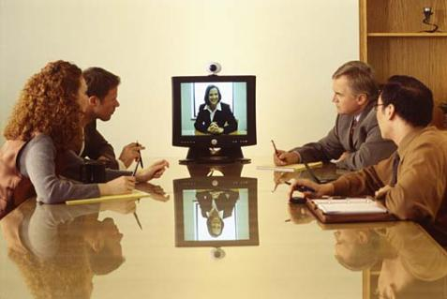
Joint distributed team
Key Features
Single project management lead
Geographically separated, but joint dev teams
Advantages
Consistent, planned development
Increased support hours
Drawbacks
Increased communication
Initially introduction of a whole dev team
Use in Mantid
ISIS – SNS Development

Slide 16

Application integration
Key Features
Integration with well known tools
Smooth transfer to/from Mantid
Rapid increase in functionality
Advantages
Can be simple file format support
Avoids reinventing the wheel
Drawbacks
Imperfect user experience
Lack of direct control
Use in Mantid
GSAS, Fullprof & other tools

Slide 17
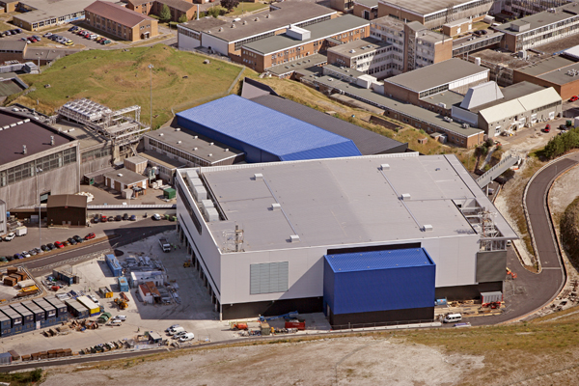
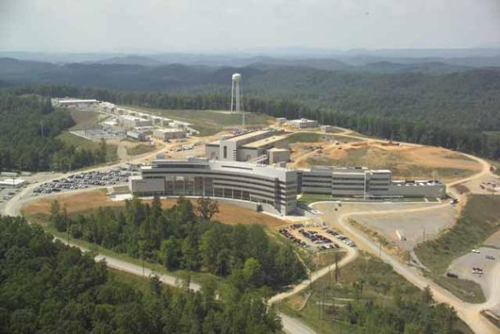
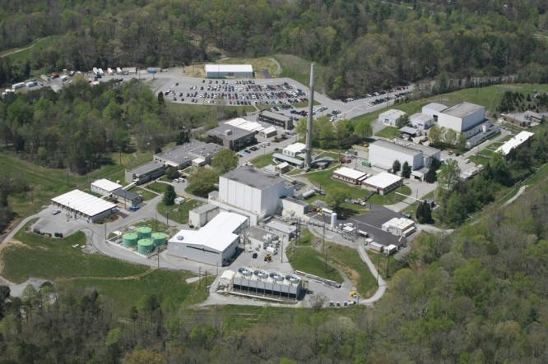
ISIS - SNS & HFIR collaboration

Slide 18
SNS Collaboration Timeline
March 2009 - ICNS 2009
Initial meeting & discussions
Oct 2009 - Due Diligence visit
Week with the development team
Discussions with several scientist users
Future plans
Areas of common interest
Jan 2010 - Go / No Go decision
Apr 2010 - Memorandum of Understanding
May 2010 - Joint development begins
Aug 2010 – Initial SNS & HFIR support

Slide 19
Previous Project Organisation
Users
Scientific Steering Committee
Development Team
27 beamlines, 1600 users
9 Key scientists representing every beamline.
PM & 7 Developers

Slide 20
Project Organisation
ISIS
SNS/HIFR
Users
Scientific Steering Committee
Development Team
Users
Scientific Steering Committee
Development Team

Slide 21
Team Structure
Joint project management board
Two scientific steering committees
One project manager
Control overall project direction
Final point of decision making
Local Development Team Leaders
One Development Team
7 FTE staff at ISIS
9+ FTE staff at SNS and still growing

Slide 22


Continuous Integration Environment
Deploy to
Download site
Mantid Project Wiki
Automated System test
SVN Repository
Build + unit test
-Linux
-Mac OSX
-Windows 32
-Windows 64
trac Issue
tracking
system
Developers

Slide 23
Communication
Face to face meetings
PM 3-4yr
Developer visit program
Developer workshops
Developer Transfer
ISIS lead developer transferred to US
Easy communication channels
Developer email list
Skype
Phone
Screen sharing
Video conferencing

Slide 24
ISIS -> SNS wins
Robust framework
Common development structure
Multithreaded performance
Documentation and training
Automated build, test and deployment
Algorithms
Over 100 algorithms already developed
Development support
help

Slide 25
SNS -> ISIS wins
Improvements to build process
Cmake, Hudson
Event Workspaces
Event Filtering
Currently by time
Will expand
Improved python code framework
New file format support
NxSPE
Event Nexus

Slide 26
Lessons Learned
Developer documentation
Need to rapidly induct several new developers
Will not be good enough
Communication
Has to be encouraged
Will take some time
Personal relationships
Are key to working together in a team
High level support is essential
No two facilities are the same
Archive structure
Information catalog

Slide 27
Lessons Learned
Minor irritations
You may have learned to live with them
Will be much more irritating to new developers
Make use of this enthusiasm
Development Environments
Will differ across facilities
Set up can be painful
Don’t let issues linger
Design
Consider implications
Design for flexibility

Slide 28
Further Information
Project Web Page
www.mantidproject.org
Project Introduction Document
http://svn.mantidproject.org/mantid/trunk/Documents/Requirements/Project%20Introduction%20Document.doc
User Requirements Document
http://svn.mantidproject.org/mantid/trunk/Documents/Requirements/URD.doc
Architectural Design Document
http://svn.mantidproject.org/mantid/trunk/Documents/Design/Architecture%20Design%20Document.doc

Slide 29

Architectural Design - Overview
Instrument log files
MantidScript
Command line & Scripting interface
Mantid Framework
RAW data files
API
Algorithms
Workspaces
MantidPlot Graphing and analysis
NEXUS data files
User Defined
User Defined
Matlab Interface
DAE direct access
Future Instrument specific UI
Future Instrument specific UI

